Slide 1
Customer Segmentation
Submitted by –
SUMEDH PATIL

Slide 2

Introduction
Welcome to the presentation on Unveiling Customer Insights: Harnessing K-means Clustering for Effective Segmentation. In this session, we will explore how K-means clustering can help businesses gain valuable customer insights and drive targeted marketing strategies. Let's dive in!

Slide 3

Understanding Customer Segmentation
Customer segmentation is the process of dividing a customer base into distinct groups or segments based on their common characteristics and behaviors. By using K-means clustering, we can identify meaningful segments in large datasets, allowing companies to tailor their offerings and communication strategies to meet the speciﬁc needs of each segment.

Slide 4
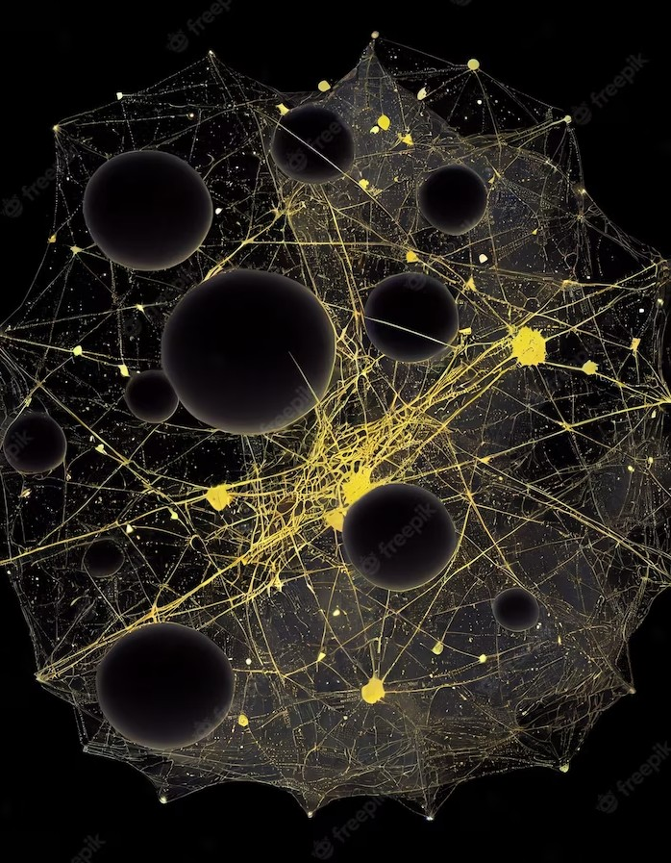
How K-means Clustering Works
K-means clustering is an unsupervised machine learning algorithm that partitions data into k clusters based on their similarities. It iteratively assigns each data point to the nearest cluster centroid and updates the centroid's position until convergence. By analyzing customer data such as demographics, purchase history, and online behavior, K-means clustering helps us identify distinct customer groups with similar characteristics.

Slide 5

Benefits of Effective Segmentation
Effective customer segmentation enables businesses to personalize marketing efforts, optimize resource allocation, and improve customer experience. It allows companies to tailor product offerings and communication channels to each segment, ensuring higher customer satisfaction and better ROI. Moreover, segmentation helps identify new market opportunities and enables targeted product development.

Slide 6

Practical Applications of K-means Clustering
K-means clustering has a wide range of applications in various industries. It can be used for customer segmentation, market basket analysis, fraud detection, recommendation systems, and more. By leveraging K-means clustering, businesses can gain valuable insights into customer behavior, enhance decision-making processes, and drive business growth.

Slide 7
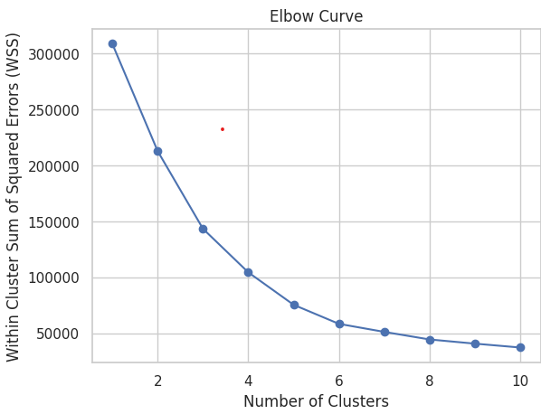
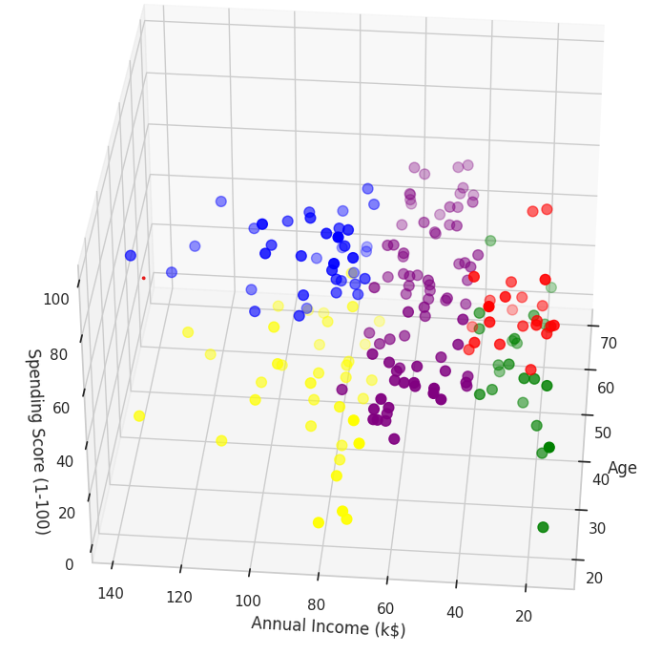
RESULT

Slide 8
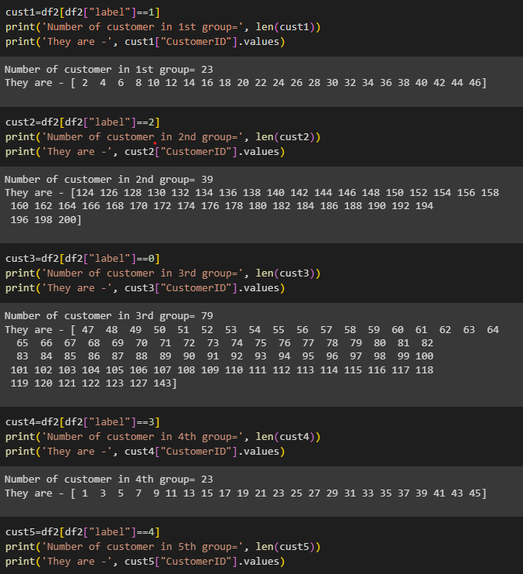
RESULT

Slide 9

Conclusion
In conclusion, K-means clustering is a powerful tool for unveiling customer insights and driving effective segmentation strategies. By understanding customer behavior and preferences, businesses can create tailored marketing campaigns, improve customer satisfaction, and boost proﬁtability.
Embracing K-means clustering can unlock the potential for businesses to stay ahead in today's competitive market.

Slide 10
Thanks

